Slide 1
Group 1: Vehicle Sales
Lauren-Ashley Rutland
Tomas Echeverria
Milena Cuao
Artem Zalivchiy

Slide 2
Vehicle Sales Data Overview
This data set shows a collection of data from 1982 to 2015 which has information related to the sales of a number of different vehicles. The data set looks at year, make, model, trim, body type, transmission type, VIN (Vehicle Identification Number), state of registration, condition rating, odometer reading, exterior and interior colors, seller information, Manheim Market Report (MMR) values, selling prices, and sale dates.
After thorough analysis of the dataset spanning from 1982 to 2015, several key trends and patterns were identified, shedding light on various aspects of the automotive market. One significant finding was the shifting popularity of vehicle makes and models over time, with certain brands experiencing surges in demand while others saw declines. Additionally, analysis of selling prices revealed trends, including fluctuations in pricing influenced by economic factors and market conditions. Furthermore, examination of color preferences among buyers uncovered interesting patterns, with certain colors consistently preferred over others across different regions and time periods. Overall, the insights obtained from this analysis provide valuable insights into consumer behavior, market dynamics, and trends in the automotive industry.

Slide 3
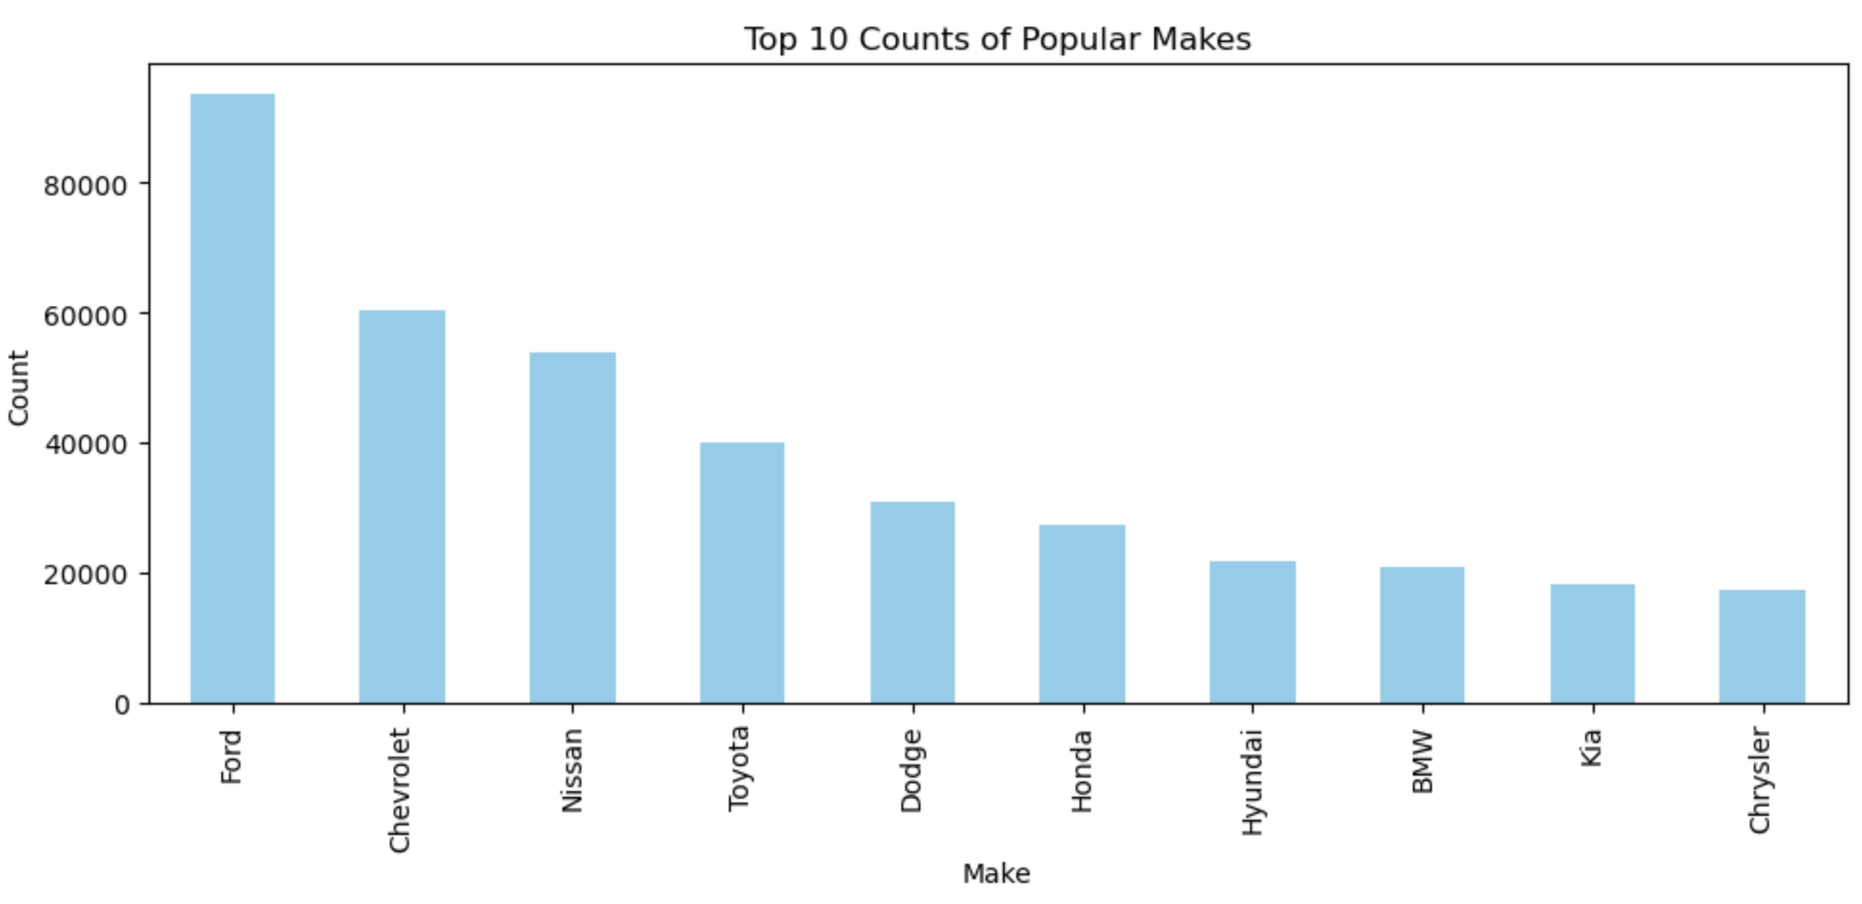
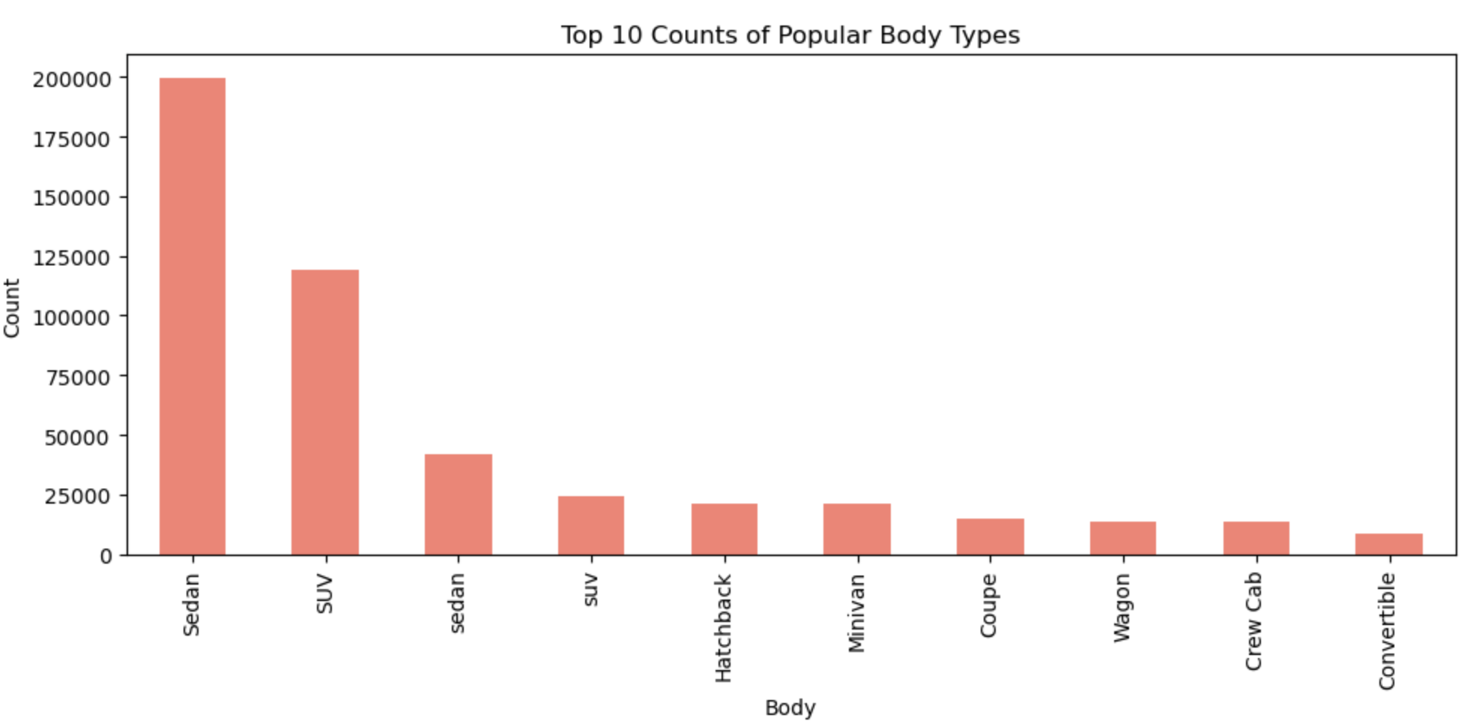
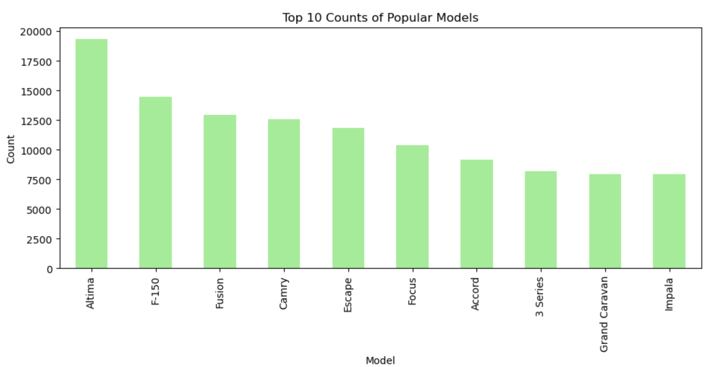
Identify the most popular makes, models and body types
When trying to identify the most popular makes, models and body types, we decided to split them up into 3 different bar graphs and examine the top 10 cars in each category. This allows us to gain insight on consumer preferences and market trends.

Slide 4
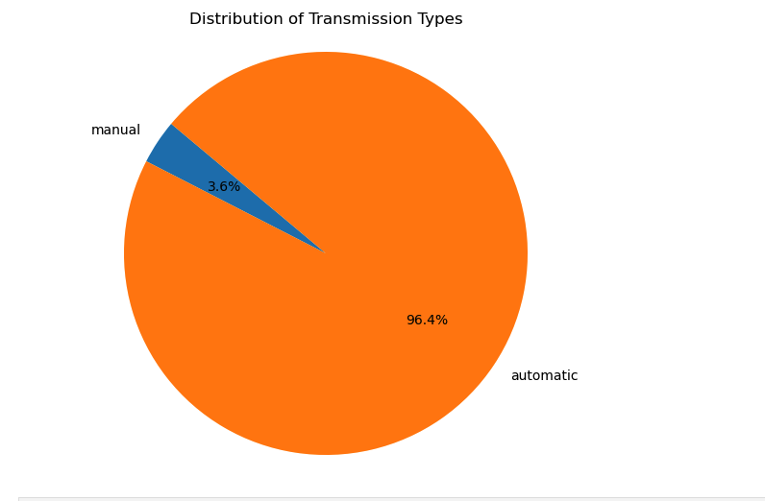
Percentage distribution of each transmission to determine which is the most popular
Pie chart shows the percentage of total automatic vs manual transmission vehicles in the data set across the entire data set. The calculations show that automatic transmission is the most popular throughout all makes and models despite the year. Several factors may contribute to this preference such as convenience and ease of use to name a few.

Slide 5
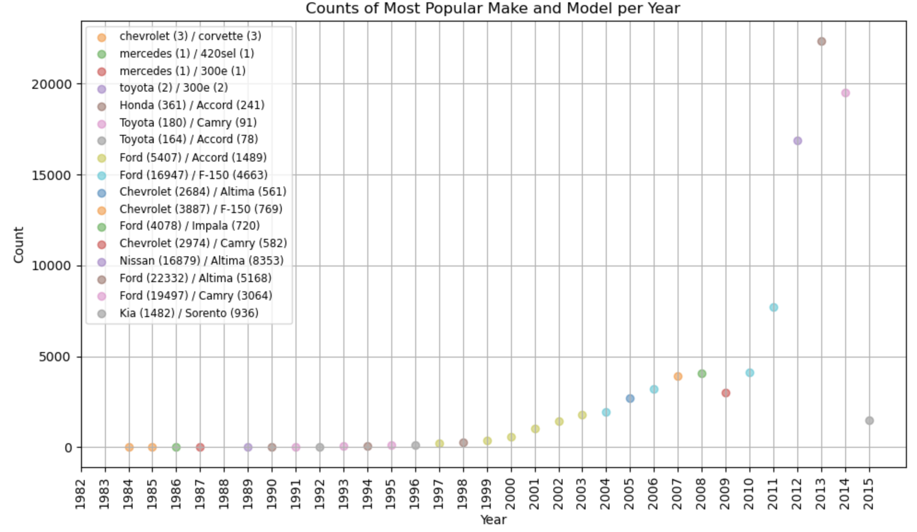
Market Trends- Most Popular make and model by year
In this question, we aimed to figure out the most popular car brands for each year. For the early years the dataset didn’t have enough data, so those data points were emitted. This allows us to see any trends in yearly purchases and what models and makes seem to be the most popular for each year

Slide 6
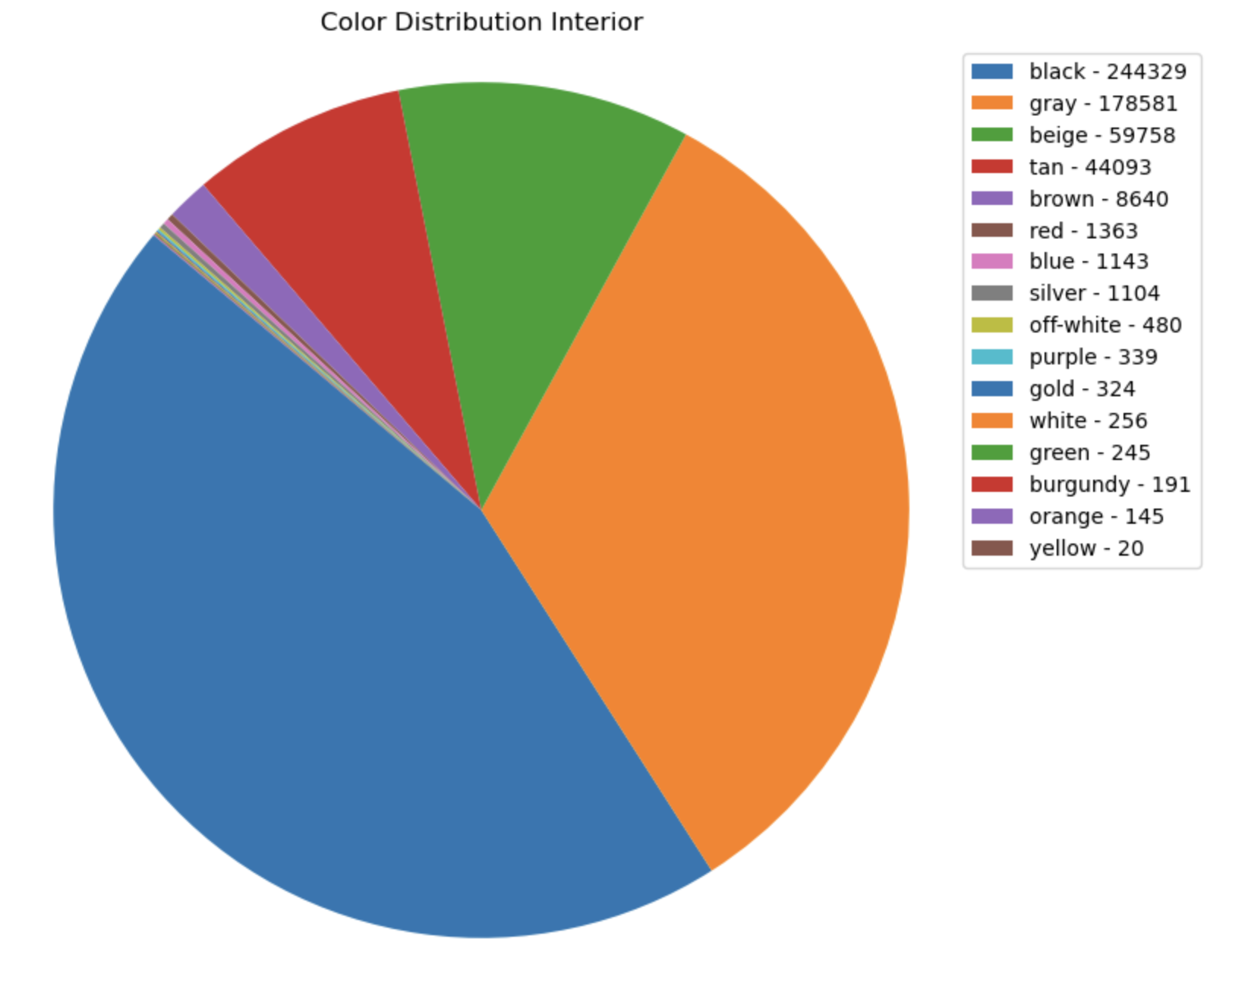
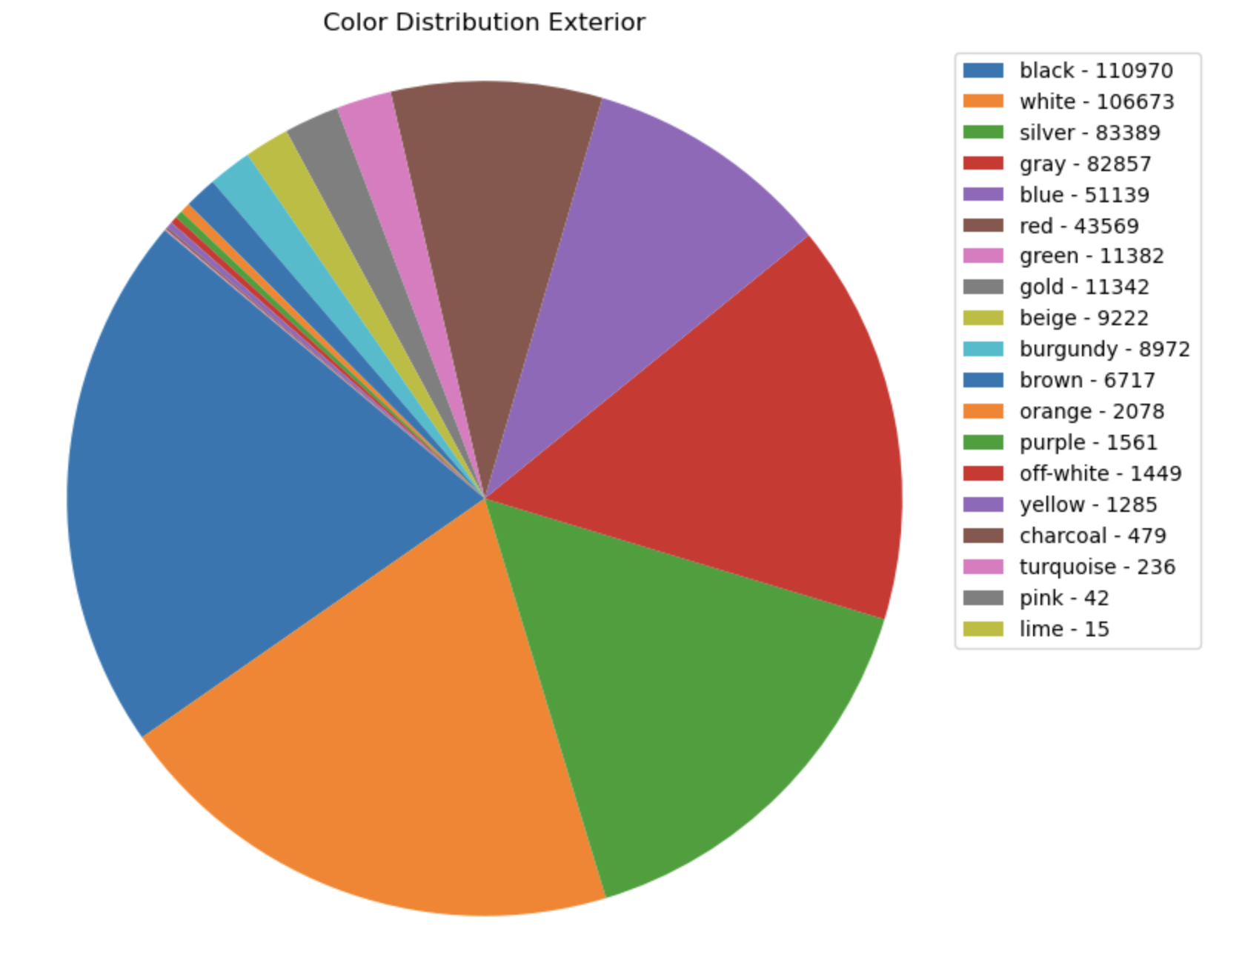
Most popular interior / exterior colors
In these graphs, our aim was to explore distribution of popular interior and exterior colors in among buyers. By analyzing the frequency of different colors in the dataset we sought to gain insight into the consumer preferences and purchasing trends.
Among Grayscale colors such as white, black, gray, and silver, black emerges as the most popular choice among vehicle buyers. Some reasons for its popularity include the fact that black is associated with modern. It’s also one of the lowest maintenance car colors to keep looking clean compared to many colors.
The first non-grayscale colors to appear on the list are tan (4th place) and brown (5th place).(brown, green, beige, orange, gold, yellow, and purple, red) account for only a small percentage of cars

Slide 7
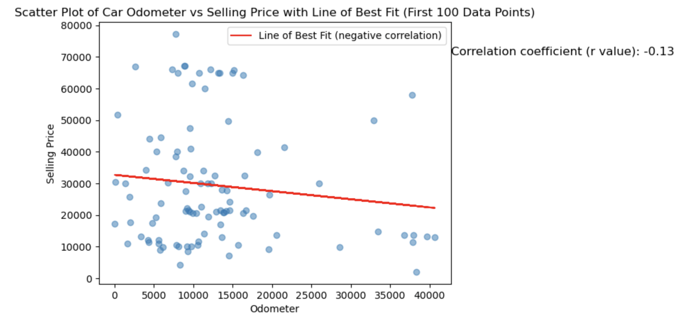
Correlation between the Odometer readings (Mileage) and the Selling Price
This graph shows the relationship between selling price and odometer reading. A scatter plot and linear regression line was shown to depict the findings. The r value of -0.13 shows negative correlation between the two variables which indicates that the selling price of the vehicles tend to be lower when the odometer(mileage) on the vehicle was higher. In other words vehicles with higher mileages tend to have a lower selling cost.

Slide 8
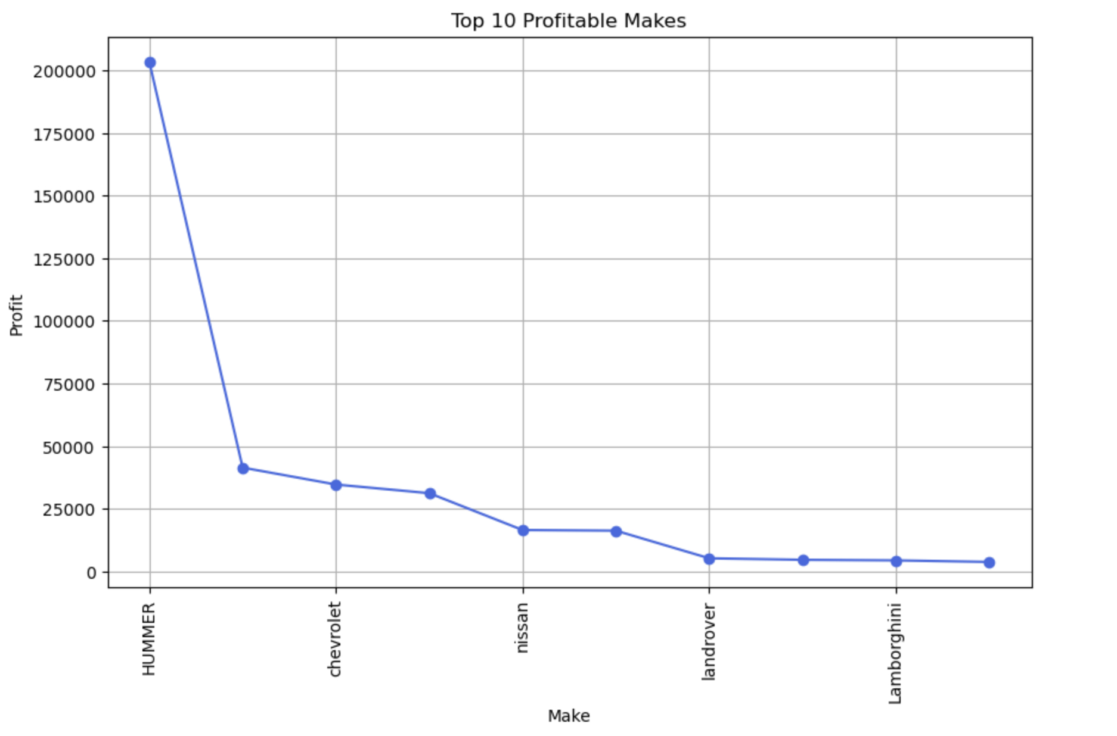
Profit based on the Make of the car
The purpose of this chart was to identify the top 10 car brands with the highest profits, showing that HUMMER with a profit of 200000, Chevrolet and Nissan have the highest profits in terms of brand, demonstrating the population's preference when buying a car.

Slide 9
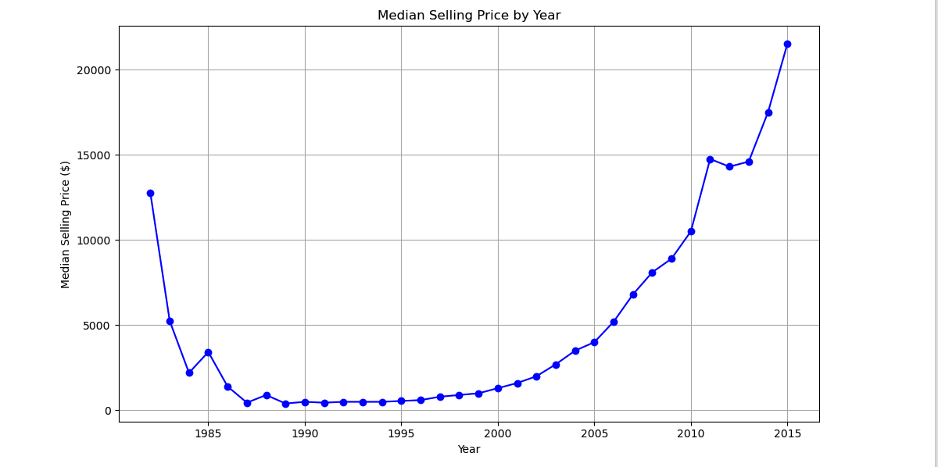
Median selling price per year throughout the data set
The line plot depicting the median selling price for vehicles over the years in the dataset reveals intriguing trends in the automotive market. Initially, there appears to be a slight decrease in the median sales value, which could be attributed to various factors such as economic downturns or shifts in consumer preferences and added features over the years. However, this initial dip is followed by a consistent upward shift, indicating an increase in the median selling price of vehicles over time.

Slide 10
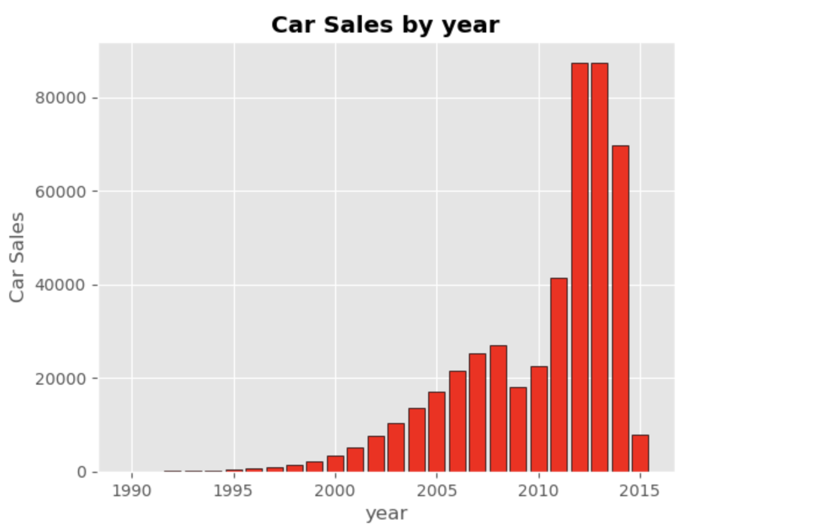
Comparison of cars sales against the year it was sold
In this bar chart, it has been possible to identify the results regarding car sales over the years, where a progressive increase in sales can be evidenced from the year 2000 to 2010, with sales ranging between $20000 and $40000 per year. It is also observed that in the years with a significant increase in car sales, this is represented between the years 2010 to 2014, exceeding the value of, $80000 per year, and finally, it is identified that in 2015, sales decreased drastically.

Slide 11
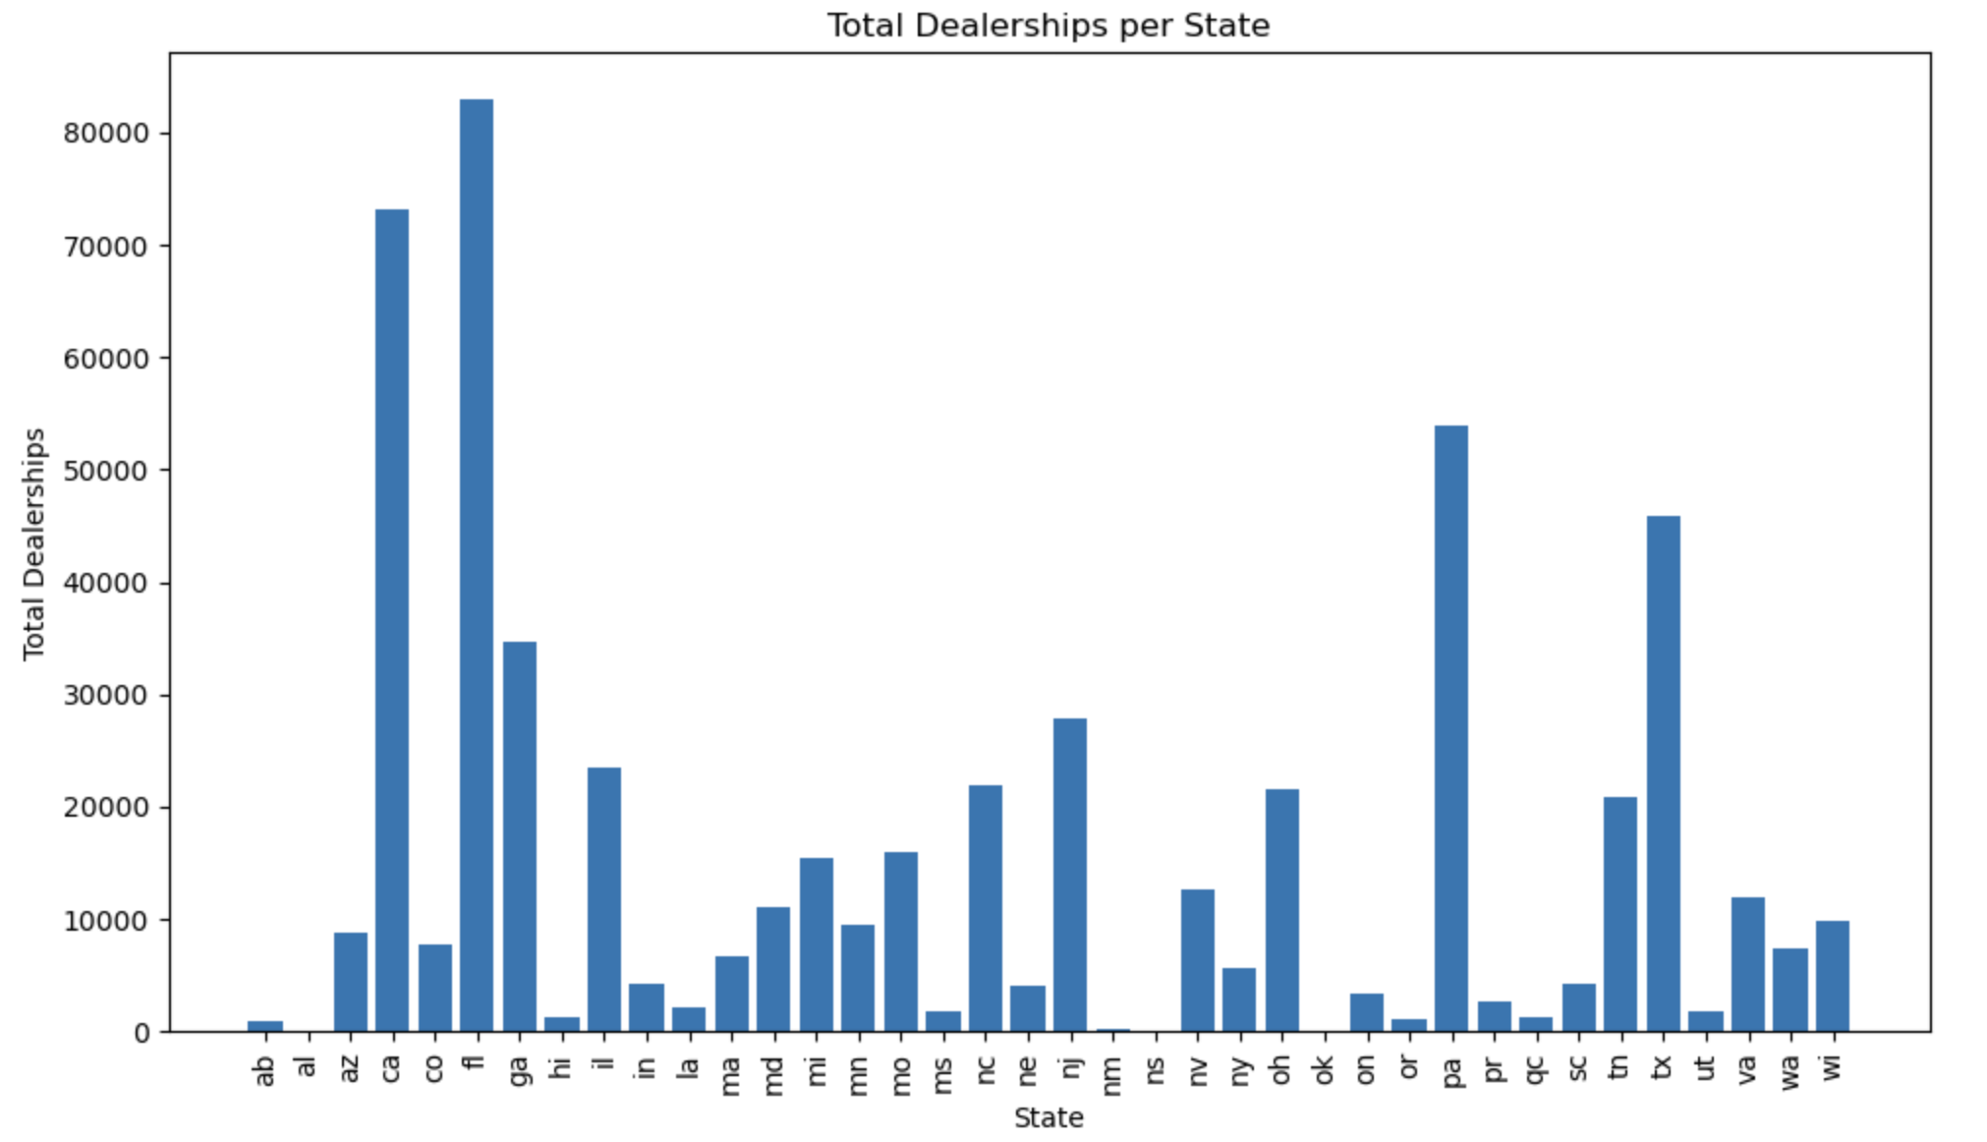
Total car dealership/sellers for all states
This graph allows to get an overview of all the total dealerships in each state. That information provides an overview of which states have the most dealerships, allowing for car suppliers to decide which states to provide the cars to. This data can also show states that possibly have more public transport options versus states that residents would be more dependent on having their own vehicle.

Slide 12
Conclusion
The Vehicle Sales Dataset serves as a valuable resource for understanding the automotive market, offering insights into consumer preferences, market dynamics, and trends over time that can influence sales. Its extensive coverage and diverse variables make it a valuable tool for anyone interested seeking to gain a deeper understanding of the automotive market and make data-driven decisions.

